Slide 1
Hardening your Linux Server's System Settings
Cybersecurity
Lesson 10.2

Slide 3

Learning Objectives
Today’s lesson will cover:
1
A brief overview of project tasks for Day 2.
2
Project work.

Slide 4

Day 2 Project Overview

Slide 5

Day 2 Tasks
Steps you will be working on today:
Auditing and securing SSH
Reviewing and updating system packages
Disabling unnecessary services
Enabling and configuring logging

Slide 6

Day 2 Tasks
Auditing and securing SSH
SSH is a common method attackers use to breach linux servers.
You will harden SSH with strict controls.

Slide 7

Day 2 Tasks
Reviewing and updating system packages
Today you will be reviewing and updating The Baker Street Corporation (BSC)’s system packages.
Having the latest version of packages minimizes security risks.

Slide 8

Day 2 Tasks
Disabling unnecessary services
Having unnecessary services running on a server increases the attack surface.
You will review and disable any of BSC’s unnecessary services.

Slide 9
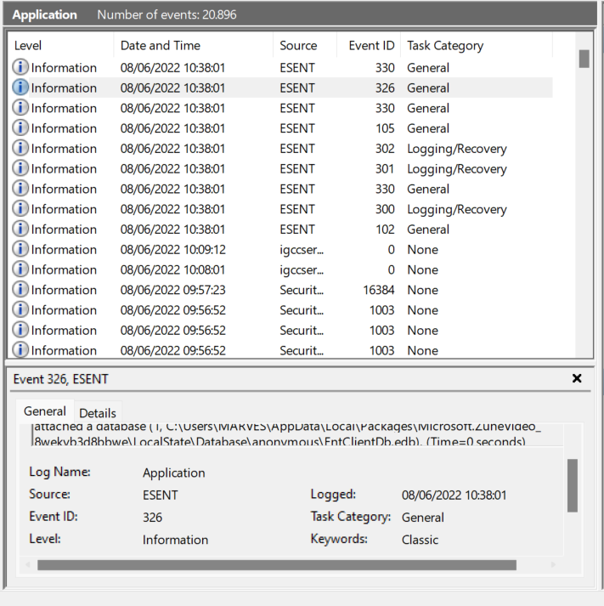
Day 2 Tasks
Enabling and configuring logging
Logging is a crucial part of the hardening process that can help identify:
Suspicious network activity
Unauthorized access
Other anomalous activity
Image attribution

Slide 11
Hardening your Linux server
For the remainder of today's class, you will work on completing Day 2
project tasks.
While you are responsible for completing your own project you can ask classmates, the TA, or the instructor to assist if you have any questions.
Remember to complete the checklist document as you progress through the activities.
Remainder of class

Slide 14
Day 3: Scripting your Linux auditing and hardening tasks

